Slide 1
OBJECT ORIENTED PROGRAMMING CONCEPTS
Chapter -3

Slide 2
CONTROL STATEMENTS
Java compiler executes the code from top to bottom. The statements in the code are executed according to the order in which they appear. However, Java provides statements that can be used to control the flow of Java code. Such statements are called control flow statements.
Decision Making statements
Simple if Statement
if…else Statement
if...else if…else statement
Nested if statement
Switch statement
Looping Statements
While
Do…while
For
For-Each Loop
Branching Statements
Break
Continue

Slide 3
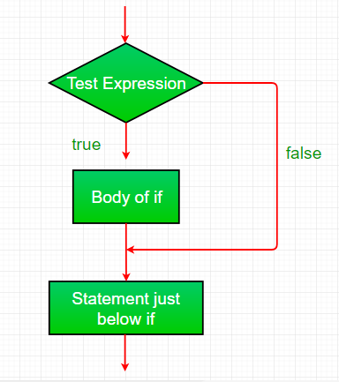
Decision Making statements
Decision-making statements are statements that decides what to execute and when. They are similar to decision making in real-time.
Simple if Statement
Simple if the statement is the basis of decision-making statements in Java. It decides if a certain amount of code should be executed based on the condition.
Syntax:
if (condition) {
Statemen 1; //if condition becomes true then this will be executed
}
Statement 2; //this will be executed irrespective of condition becomes true or false

Slide 4
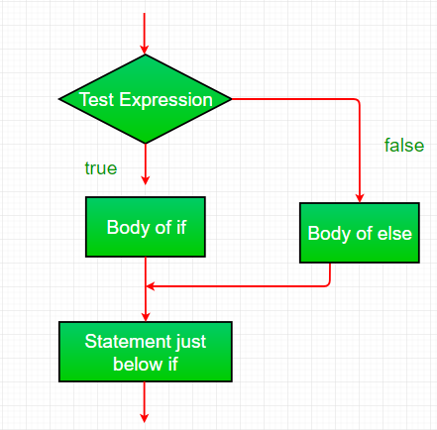
If Else Statement
In if…else statement, if the condition is true then statements in if block will be executed but if it comes out as false then else block will be executed
Syntax:
if (condition) {
Statemen 1; //if condition becomes true then this will be executed
}
Else{
Statement 2; // if condition becomes false then this will be executed
}

Slide 5
Example program
public class Student {
public static void main(String[] args) {
int x = 10;
int y = 12;
if(x+y < 10)
{
System.out.println("x + y is less than 10");
}
else
{
System.out.println("x + y is greater than 20");
}
}
}
Output:
x + y is greater than 20

Slide 6
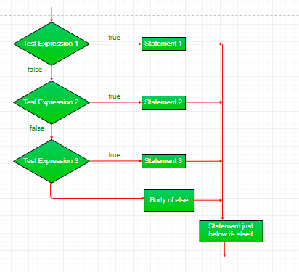
if-else-if ladder:
The if-else-if statement contains the if-statement followed by multiple else-if statements. In other words, we can say that it is the chain of if-else statements that create a decision tree where the program may enter in the block of code where the condition is true. We can also define an else statement at the end of the chain.
Syntax:
if (condition2) {
Statemen 1; //if condition1 becomes true then this will be executed
}
else if (condition2) {
Statement 2; // if condition2 becomes true then this will be executed
}
else {
Statement 3; //executed when no matching condition found
}

Slide 7
Example program
public class Student {
public static void main(String[] args) {
String city = “Rajampet";
if(city == “kadapa") {
System.out.println("city is kadapa");
}
else if (city == “pullampet") {
System.out.println("city is pullampet");
}
else if(city == “utukur") {
System.out.println("city is utukur");
}
else {
System.out.println(city);
}
}
}
Output:
Rajampet

Slide 8
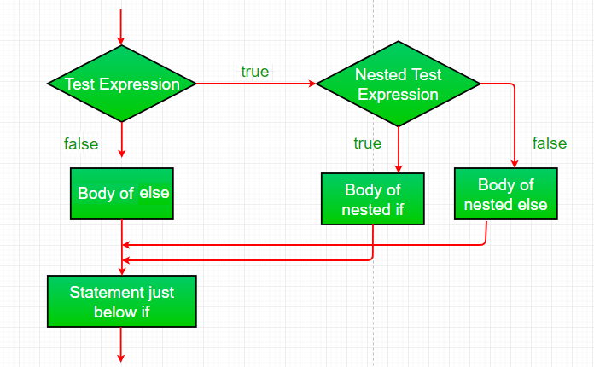
Nested if
The nested if statement is inside an if block. It is same as normal if..else statements but they are written inside another if..else statement.
Syntax:
if (condition1) {
Statemen 1; //executed when condition1 is true
if (condition2) {
Statement 2; //executed when condition2 is true
}
else {
Statement 3; //executed when condition2 is false
}
}

Slide 9
Example program
public class Student {
public static void main(String[] args) {
int age = 20;
String gender = "male";
if (age > 18) {
if (gender == "male") {
System.out.println("You can shop in the men's section on the 3rd Floor" );
}
else {
System.out.println("You can shop in the women's section on 2nd Floor");
}
}
else {
System.out.println("You can shop in the kid's section on 1st Floor");
}
}
}
Output:
You can shop in the men's section on the 3rd Floor

Slide 10
Branching statements
Example:
class breakTest
{
public static void main(String args[])
{
for (int j = 0; j < 5; j++)
{
// come out of loop when i is 4.
if (j == 4)
break;
System.out.println(j);
}
System.out.println("After loop");
}
}
Output:
0
1
2
3
4
After loop
Branching statements jump from one statement to another and transfer the execution flow. There are 3 branching statements in Java.
Break
Break statement is used to terminate the execution and bypass the remaining code in loop. It is mostly used in loop to stop the execution and comes out of loop. When there are nested loops then break will terminate the innermost loop.

Slide 11
Example:
class continueTest
{
public static void main(String args[])
{
for (int j = 0; j < 10; j++)
{
// If the number is odd then bypass and continue with next value
if (j%2 != 0)
continue;
// only even numbers will be printed
System.out.print(j + " ");
}
}
}
Output:
0 2 4 6 8
Continue
Continue statement works same as break but the difference is it only comes out of loop for that iteration and continue to execute the code for next iterations. So it only bypasses the current iteration.

Slide 12
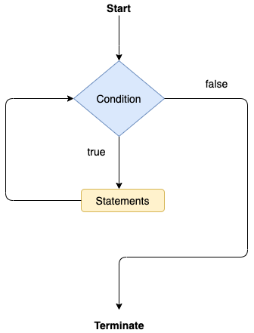
Looping statements
Looping statements are the statements which executes a block of code repeatedly until some condition meet to the criteria. Loops can be considered as repeating if statements. There are 3 types of loops available in Java.
While
While loops are simplest kind of loop. It checks and evaluates the condition and if it is true then executes the body of loop. This is repeated until the condition becomes false. Condition in while loop must be given as a Boolean expression. If int or string is used instead, compile will give the error of code should be executed based on the condition.
Syntax:
while (condition)
{
statement1;
}

Slide 13
Example program
class whileLoopTest
{
public static void main(String args[])
{
int j = 1;
while (j <= 10)
{
System.out.println(j);
j = j+2;
}
}
}
Output:
1
3
5
7
9

Slide 14
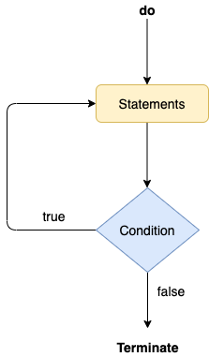
Do…While
Do…while works same as while loop. It has only one difference that in do…while condition is checked after the execution of the loop body. That is why this loop is considered as exit control loop. In do…while loop, body of loop will be executed at least once before checking the condition
Syntax:
do{
statement1;
}while(condition);

Slide 15
Example program
class dowhileLoopTest
{
public static void main(String args[])
{
int j = 10;
do
{
System.out.println(j);
j = j+1;
} while (j <= 10)
}
}
Output:
10

Slide 16
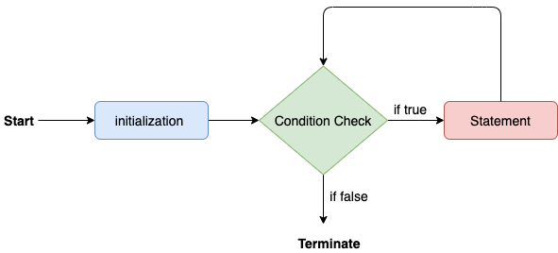
For While
It is the most common and widely used loop in Java. It is the easiest way to construct a loop structure in code as initialization of a variable, a condition and increment/decrement are declared only in a single line of code. It is easy to debug structure in Java.
Syntax:
for (initialization; condition; increment/decrement)
{
statement;
}

Slide 17
Example program
class forLoopTest
{
public static void main(String args[])
{
for (int j = 1; j <= 5; j++)
System.out.println(j);
}
}
Output:
1
2
3
4
5

Slide 18
Example program
class foreachDemo{
public static void main(String args[]){
int a[] = {10,15,20,25,30};
for (int i : a) {
System.out.println(i);
}
}
For Each loop
For-Each loop is used to traverse through elements in an array. It is easier to use because we don’t have to increment the value. It returns the elements from the array or collection one by one.
Syntax:
for(data_type variable : array | collection){
//body of for-each loop
}
Output:
10
15
20
25
30

Slide 19
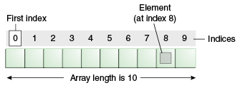
Arrays
Normally, an array is a collection of similar type of elements which has contiguous memory location.
Java array is an object which contains elements of a similar data type. Additionally, The elements of an array are stored in a contiguous memory location
Advantages
Code Optimization: It makes the code optimized, we can retrieve or sort the data efficiently.
Random access: We can get any data located at an index position.
Disadvantages
Size Limit: We can store only the fixed size of elements in the array. It doesn't grow its size at runtime. To solve this problem, collection framework is used in Java which grows automatically.
Types of Array in java
There are two types of array.
Single Dimensional Array
Multidimensional Array

Slide 20
Single Dimensional Array in Java
Syntax to Declare an Array in Java
dataType[] arr;
(or)
dataType []arr;
(or)
dataType arr[];
Example of Java Array
Let's see the simple example of java array, where we are going to declare, instantiate, initialize and traverse an array.
//Java Program to illustrate how to declare, instantiate, initialize and traverse the Java array.
class Testarray{
public static void main(String args[]){
int a[]=new int[5];//declaration and instantiation
a[0]=10;//initialization
a[1]=20;
a[2]=70;
a[3]=40;
a[4]=50;
//traversing array
for(int i=0;i<a.length;i++)//length is the property of array
System.out.print(a[i]+” “ );
}}
Output:
10 20 70 40 50
Declaration of an Array in Java
arrayRefVar=new datatype[size];

Slide 21
Multidimensional Array in Java
Example to instantiate Multidimensional Array
int[][] arr=new int[3][3];//3 row and 3 column
Example to initialize Multidimensional Array
arr[0][0]=1;
arr[0][1]=2;
arr[0][2]=3;
arr[1][0]=4;
arr[1][1]=5;
arr[1][2]=6;
arr[2][0]=7;
arr[2][1]=8;
arr[2][2]=9;
Syntax to Declare Multidimensional Array
in Java
dataType[][] arrayRefVar;
(or)
dataType [][]arrayRefVar;
(or)
dataType arrayRefVar[][];
(or)
dataType []arrayRefVar[];

Slide 22
Example of Multidimensional Java Array
Let's see the simple example to declare, instantiate, initialize and print the 2Dimensional array.
//Java Program to illustrate the use of multidimensional array
class Testarray3{
public static void main(String args[]){ //declaring and initializing 2D array
int arr[][]={{1,2,3},{2,4,5},{4,4,5}}; //printing 2D array
for(int i=0;i<3;i++){
for(int j=0;j<3;j++){
System.out.print(arr[i][j]+" ");
}
System.out.println();
}
}}
Output:
1 2 3 2 4 5 4 4 5

Slide 23
Operators
Operator Type | Category | Precedence
Unary | postfix | expr++ expr--
 | prefix | ++expr --expr +expr -expr ~ !
Arithmetic | multiplicative | * / %
 | additive | + -
Shift | shift | << >> >>>
Relational | comparison | < > <= >= instanceof
 | equality | == !=
Bitwise | bitwise AND | &
 | bitwise exclusive OR | ^
 | bitwise inclusive OR | |
Logical | logical AND | &&
 | logical OR | ||
Ternary | ternary | ? :
Assignment | assignment | = += -= *= /= %= &= ^= |= <<= >>= >>>=
Operator in Java is a symbol that is used to perform operations. For example: +, -, *, / etc.
There are many types of operators in Java which are given below:

Slide 24
Method Overloading
If a class has multiple methods having same name but different in parameters, it is known as Method Overloading.
If we have to perform only one operation, having same name of the methods increases the readability of the program.
Method overloading increases the readability of the program.
Different ways to overload the method
There are two ways to overload the method in java
By changing number of arguments
By changing the data type

Slide 25
1) Method Overloading: changing no. of arguments
In this example, we have created two methods, first add() method performs addition of two numbers and second add method performs addition of three numbers.
In this example, we are creating static methods so that we don't need to create instance for calling methods.
Example:
class Adder{
static int add(int a,int b){
return a+b; }
static int add(int a,int b,int c){
return a+b+c; }
}
class TestOverloading1{
public static void main(String[] args){
System.out.println(Adder.add(11,11));
System.out.println(Adder.add(11,11,11));
}}
Output:
22
33
2) Method Overloading: changing data type of arguments
In this example, we have created two methods that differs in data type. The first add method receives two integer arguments and second add method receives two double arguments.
Example:
class Adder{
static int add(int a, int b){
return a+b; }
static double add(double a, double b){
return a+b;
}
}
class TestOverloading2{
public static void main(String[] args){
System.out.println(Adder.add(11,11));
System.out.println(Adder.add(12.3,12.6));
}
}
Output:
22
24.9

Slide 26
Method Overriding
Example
//Java Program to illustrate the use of Java Method Overriding
//Creating a parent class.
class Vehicle{
//defining a method
void run(){System.out.println("Vehicle is running");}
}
//Creating a child class
class Bike2 extends Vehicle{
//defining the same method as in the parent class
void run(){System.out.println("Bike is running safely");}
public static void main(String args[]){
Bike2 obj = new Bike2();//creating object
obj.run();//calling method
}
}
Output:
Bike is running safely
If subclass (child class) has the same method as declared in the parent class, it is known as method overriding in Java.
In other words, If a subclass provides the specific implementation of the method that has been declared by one of its parent class, it is known as method overriding.

Slide 27
Recursion
Example
public class RecursionExample2 {
static int count=0;
static void p(){
count++;
if(count<=5){
System.out.println("hello "+count);
p(); } }
public static void main(String[] args) {
p(); } }
Output:
hello 1
hello 2
hello 3
hello 4
hello 5
Recursion in java is a process in which a method calls itself continuously. A method in java that calls itself is called recursive method.
It makes the code compact but complex to understand.
Syntax:
returntype methodname(){
//code to be executed
methodname();//calling same method
}

Slide 28
String Handling
Strings, which are widely used in Java programming, are a sequence of characters. In Java programming language, strings are treated as objects.
The Java platform provides the String class to create and manipulate strings.
The most direct way to create a string is to write −
String greeting = "Hello world!";
Whenever it encounters a string literal in your code, the compiler creates a String object with its value in this case, "Hello world!'.
public class StringDemo {
public static void main(String args[]) {
char[] helloArray = { 'h', 'e', 'l', 'l', 'o', '.' };
String helloString = new String(helloArray);
System.out.println( helloString );
}
}
Output
hello.

Slide 29
String Handling Methods
1. String Creation: Strings can be created in Java using the `String` class, which represents a sequence of characters. You can create a string using either a string literal or the `new` keyword.
Example:
String str1 = "Hello, World!"; // using string literal
String str2 = new String("Hello, World!"); // using the new keyword
2. String Concatenation: Java allows you to concatenate strings using the `+` operator or the `concat()` method.
Example:
String str1 = "Hello";
String str2 = "World";
String result = str1 + ", " + str2; // using the + operator
String result2 = str1.concat(", ").concat(str2); // using the concat() method

Slide 30
3. String Length: The `length()` method returns the number of characters in a string.
Example:
String str = "Hello, World!";
int length = str.length(); // returns 13
4. String Comparison: Strings can be compared for equality using the `equals()` method or the `==` operator. The `compareTo()` method compares two strings lexicographically.
Example:
String str1 = "Hello";
String str2 = "Hello";
boolean isEqual = str1.equals(str2); // returns true
int comparisonResult = str1.compareTo(str2); // returns 0

Slide 31
5. Substring Extraction: The `substring()` method allows you to extract a portion of a string based on a specified starting and ending index.
Example:
String str = "Hello, World!";
String substring = str.substring(7, 12); // returns "World"
6. String Modification: Strings in Java are immutable, meaning they cannot be changed once created. However, you can create a modified version of a string using methods like `replace()`, `toUpperCase()`, `toLowerCase()`, and others.
Example:
String str = "Hello, World!";
String modifiedStr = str.replace("Hello", "Hi"); // returns "Hi, World!".

